Slide 1

Welcome to Statistical Analysis Workshop
Get ready to learn about the importance of statistical analysis and the free tools available to you.
We'll cover Excel and RStudio, two powerful platforms that can help you take your data analysis to the next level.
Gideon Alake

Slide 2
In the Beginning Was Excel
Data Preparation
Web Scraping
Mapping
Excel isn't just for spreadsheets! I'll show you how to use validation, naming conventions, and transformations to get your data ready for analysis.
Learn how to scrape data from the web using Excel, a powerful yet easy-to-use tool.
Get an overview of Excel's mapping capabilities, and learn how to create powerful, visual representations of your data.
Add-Ins
Unlock new features and extended functionality with Excel's add-ins, designed to help you optimize
your workflow.

Slide 3
RStudio - A Comprehensive Analysis Tool
Data Analysis
We'll walk you through basic and advanced analysis in RStudio, including data exploration, graphics, and reporting.
1
2
3
Capabilities
Good Practices
Learn about the robust features that make RStudio a top choice for data analysts and scientists alike.
Gain insight into the best coding practices for R programming, and learn how to write clean, efficient, and reproducible code.

Slide 4
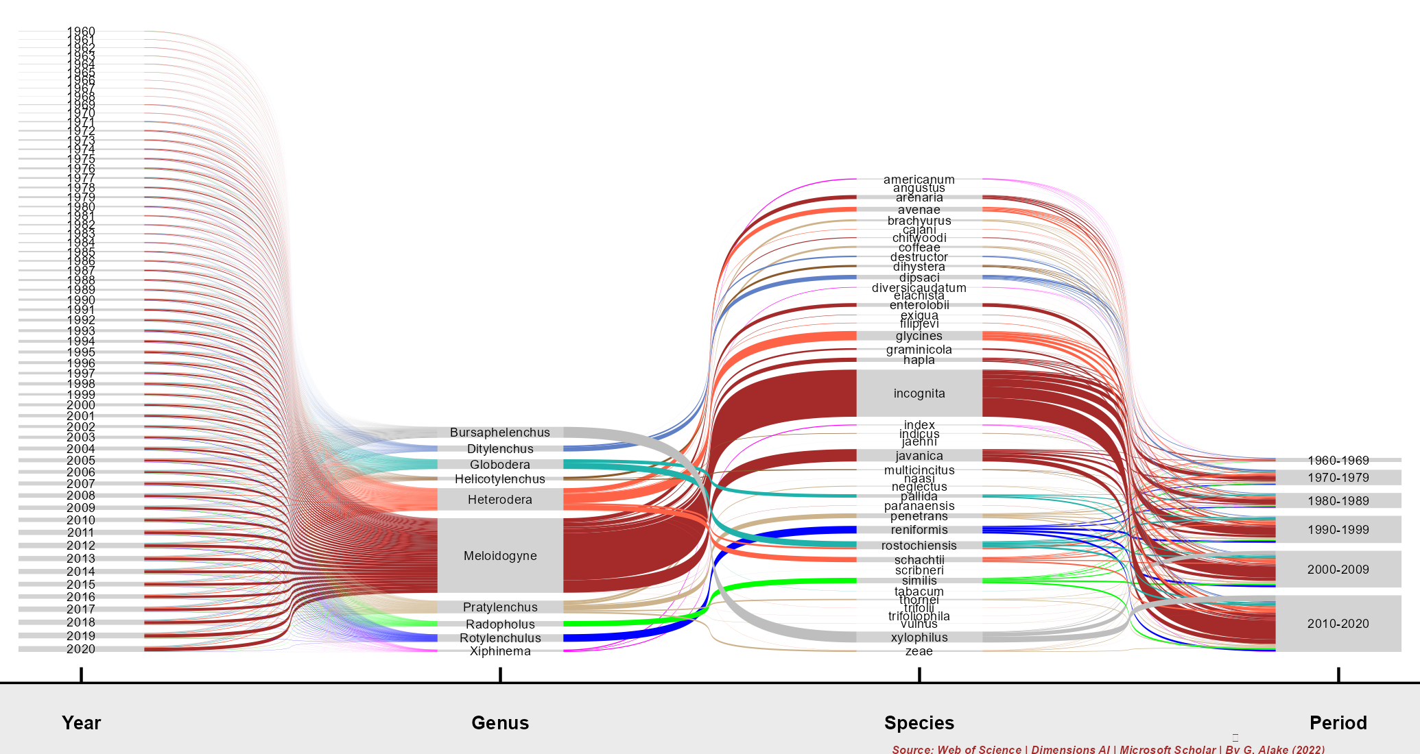
RStudio - A Comprehensive Analysis Tool

Slide 5
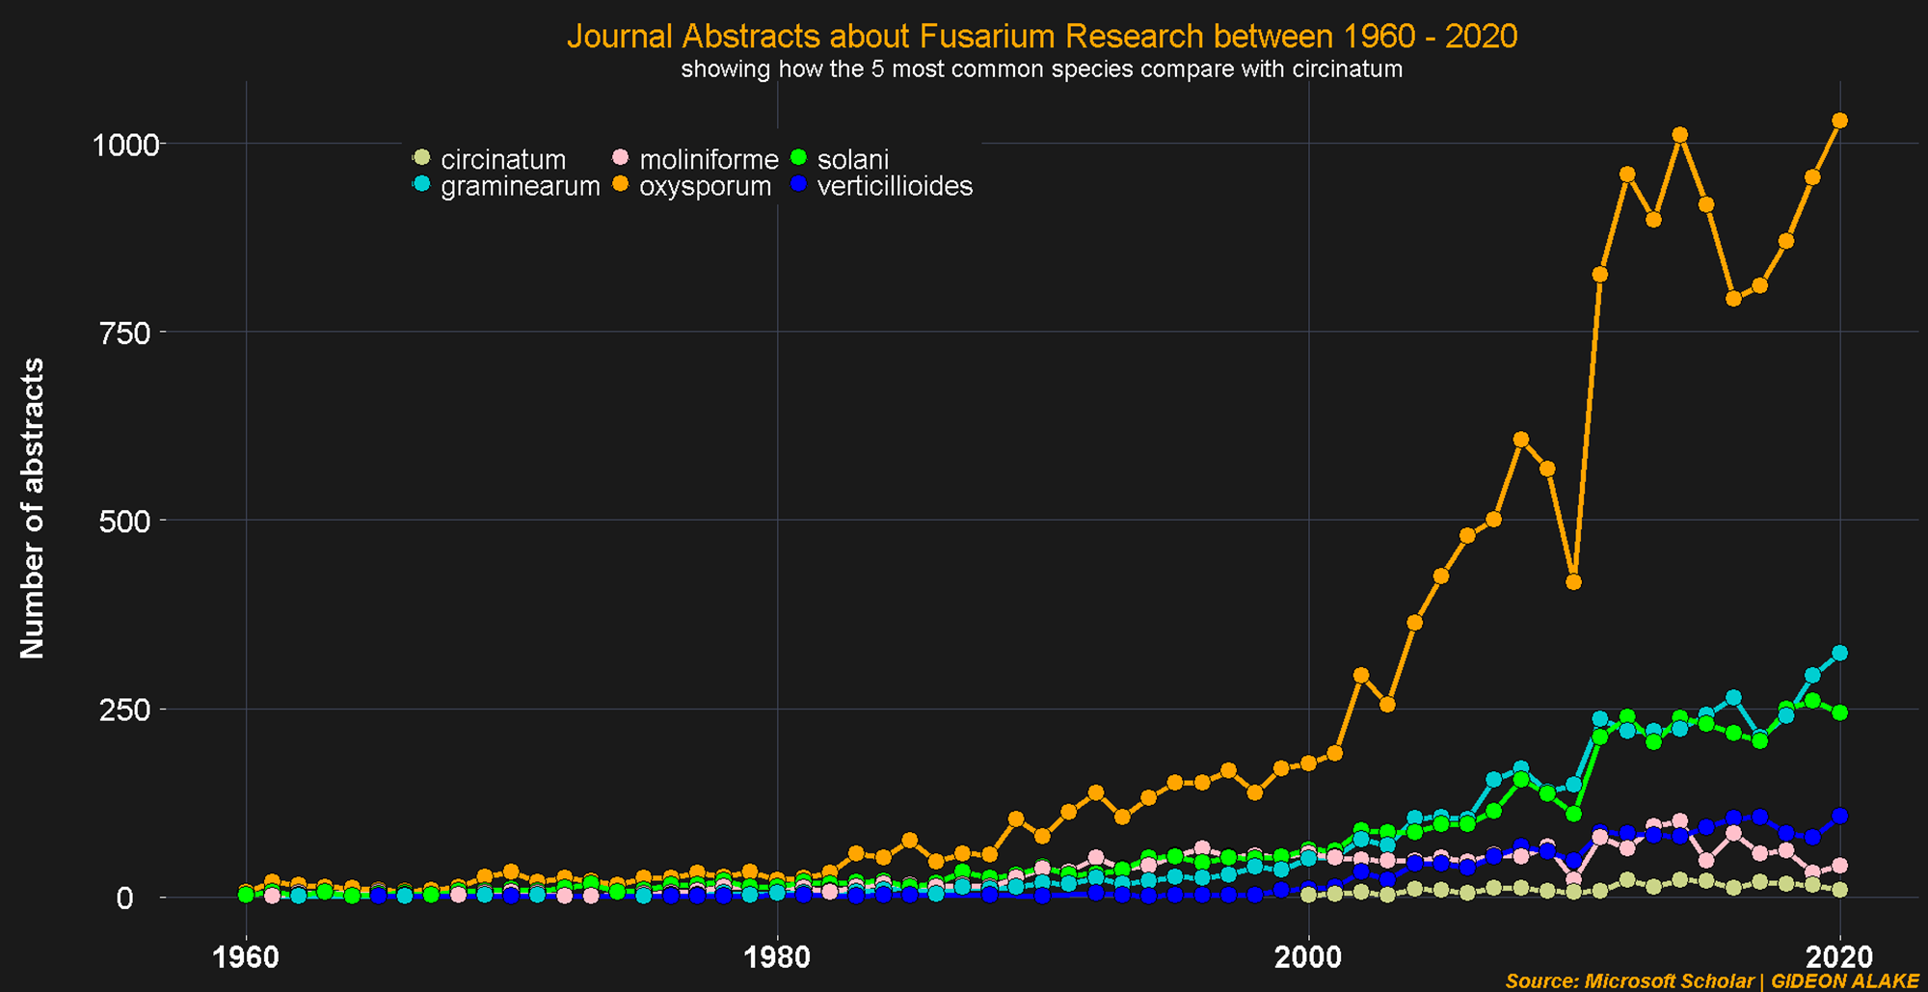
RStudio - A Comprehensive Analysis Tool

Slide 6
RStudio - A Comprehensive Analysis Tool

Slide 7
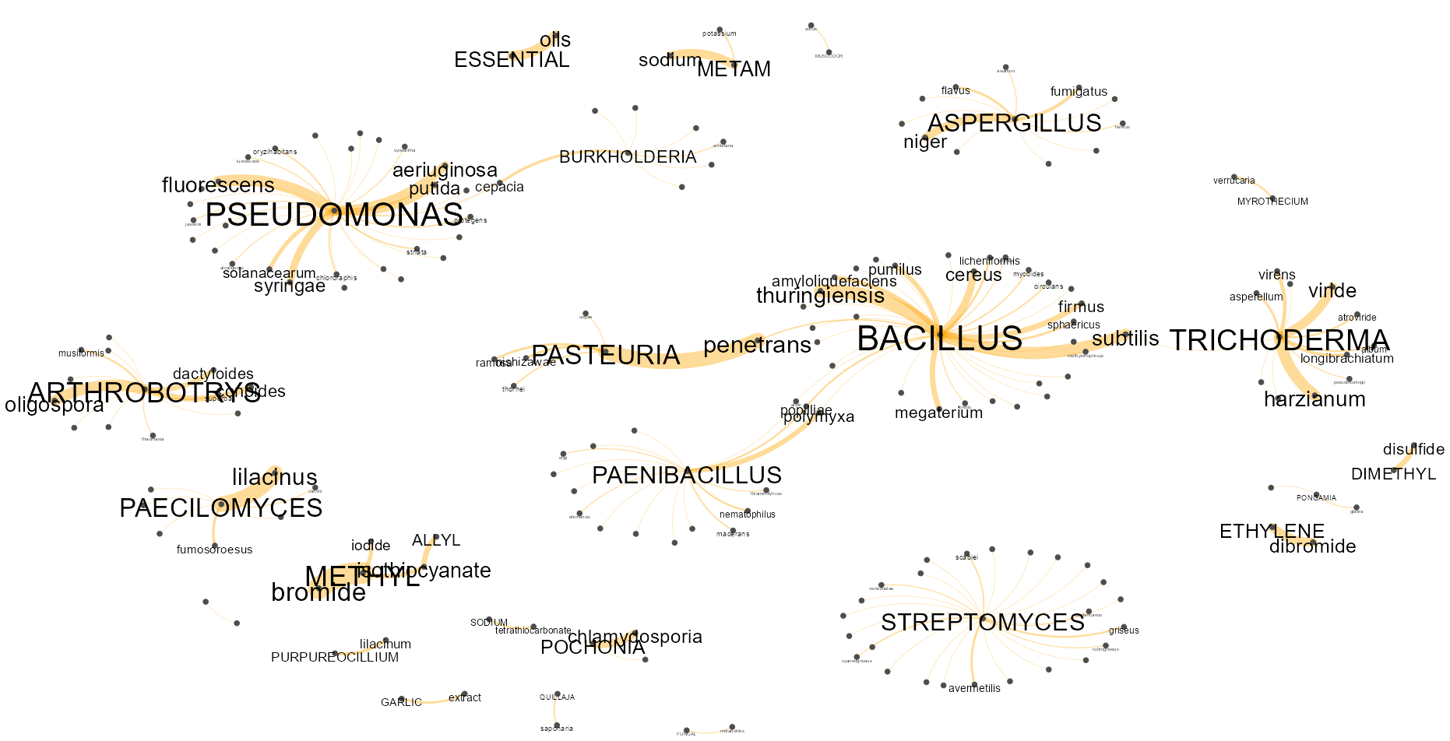
Bio/Nematicide Representatives (1960 - 2020)

Slide 8

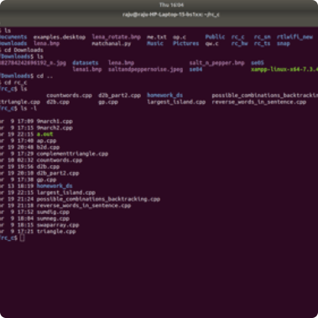

Linux Programming in RStudio
Overview
CLI
Coding Best Practices
Explore the world of Linux programming in RStudio, and learn how to harness its power for your own data analysis projects.
Dive into the command line interface (CLI), an essential tool in Linux programming, and learn how to navigate and manipulate files like a pro.
Get tips and tricks for writing efficient and effective code in Linux programming with RStudio.

Slide 9
More on RStudio
1
Data Visualization
Uncover the art of data visualization in RStudio, and learn how to create eye-catching charts, graphs, and more.
2
Web Apps
Put your skills to the test with our step-by-step tutorial on developing web apps in RStudio.
3
Python Integration
Discover the power of Python integration in RStudio, and learn how to use both languages together to unlock new capabilities.
4
Add-Ins
Find out how add-ins can help you extend RStudio's functionality, and explore some popular add-ins for a more seamless workflow.

Slide 10

Choosing the Right Tool
1
Excel
2
RStudio
3
Consider Your Needs
Choose Excel for its ease of use, powerful data preparation capabilities, and user-friendly interface.
Opt for RStudio if you need a more comprehensive solution with advanced analysis, visualization, and programming capabilities.
Ultimately, the best choice for you will depend on your specific needs and goals. Analyze your data requirements carefully before making a decision.

Slide 11
The Power of Data Analysis
Improved Decision Making
Faster Results
Enhanced Productivity
Streamline your workflow and get results faster with powerful data analysis tools like Excel and RStudio.
Reduce errors, save time, and boost productivity with automated data analysis and visualization.
Get the insights you need to make better decisions and drive your organization forward.

Slide 12
Best Practices for Statistical Analysis
1.
Define your problem and goals clearly before beginning any analysis.
2.
Use proper data preparation techniques to ensure accuracy and consistency.
3.
Choose the right tools for the job based on your specific needs and goals.
4.
Take steps to ensure reproducibility by using version control and following best coding practices.
5.
Visualize your data with charts, graphs, and other methods to gain deeper insights.

Slide 13
Final Thoughts
Takeaway
Next Steps
Remember, data analysis is a powerful tool that can help you make better decisions, achieve results faster, and enhance productivity. Use Excel and RStudio to unlock the full potential of your data.
Explore our website for more resources and tutorials on data analysis, or sign up for our advanced workshops to take your skills to the next level.

